Slide 1
Gesture Based UI Development
By ABIGAIL culkin and SaraH cARROLL

Slide 2
Project Idea
Create a remote control car controlled by myo armband.
The remote control car will be controlled by an Arduino board.

Slide 3
Process of development
We built a remote control car using an Arduino board, and motor controller and Bluetooth connector.
We programmed the Arduino to control the movement of the car first by using a joystick.
We then programmed the Myo Armband to control the movement of the car using gestures for different movements.

Slide 4
Chosen Gestures
To begin movement user must gesture finger spread. This is a release movement as the car is taking off.
To control the cars direction the user waves right and left. We chose these gestures as you are waving your hand in the same direction you want the car to move. The turning has limitations.
To stop the movement the user must rest their arm.
To straighten the wheels the user performs a fist motion. This is a tightening movement that will get the car back to its starting position.
We have used the double tap to control the LED lights to go on and off. This is similar to a switching motion.

Slide 5
Software Used
We developed the code using Ino which is the same as C++. Arduino software saves the files in Ino.
The code is then sent to the Arduino board which stores it in order to run.
We had to use a MyoDuino library in order to incorporate the Myo Armband to recognise the gestures.

Slide 6
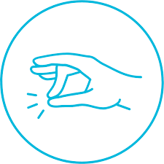
Gestures
Double Tap
Finger Spread
Wave Left
Wave Right
Fist

Slide 7
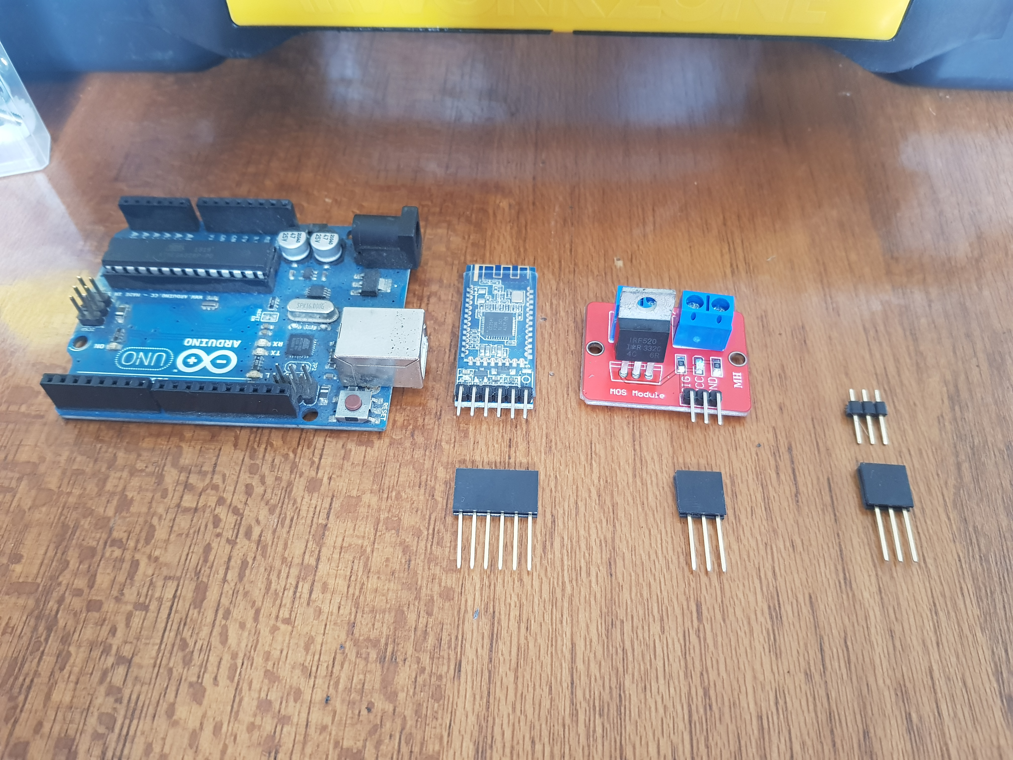
Arduino Development
The Arduino board is a micro processor which
stores the code so you can program
any movement from the Arduino.
The Bluetooth connector allows you to run the Arduino software from the computer without the hardwire being connected.
The motor controller allows an external power
supply to supply more power then the Arduino can
The connectors are used for soldering joints
to the boards temporarily and not directly

Slide 8
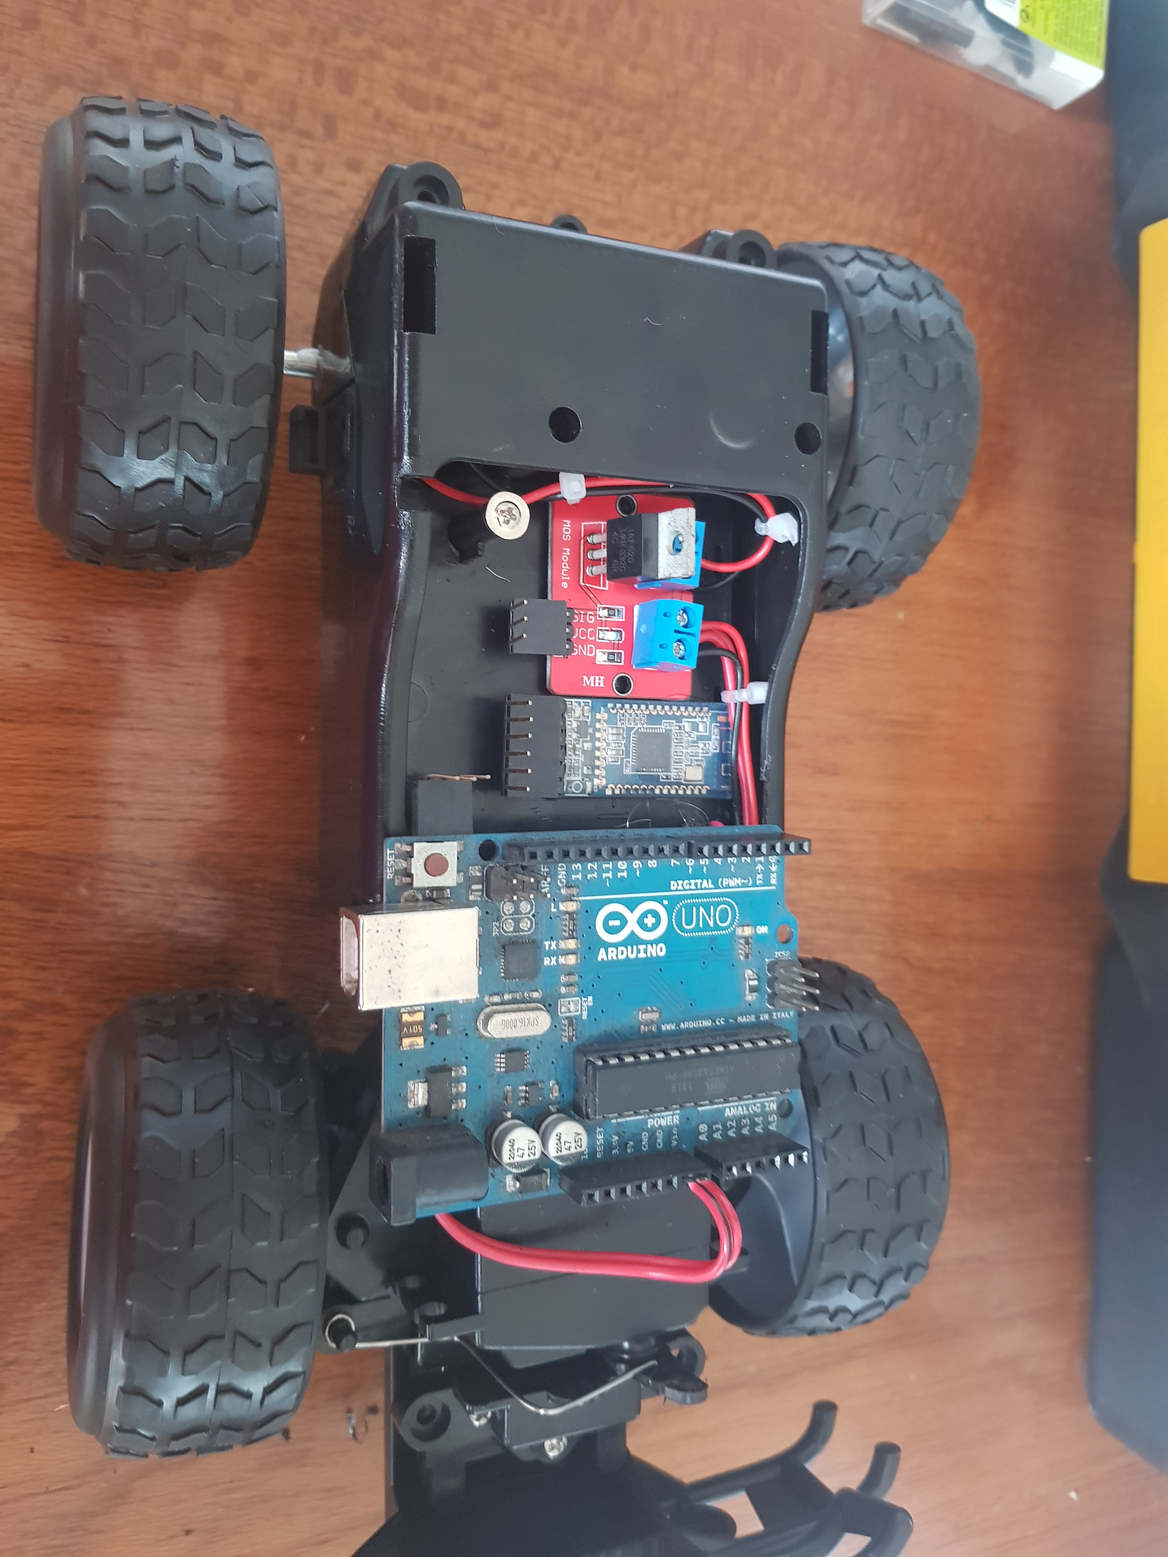
Arduino Development
The motor controller and the Arduino board are connected
To the battery power.
The motor controller is also connected to the motor in the
remote control car to allow movement of the wheels.
There is an red roof to go over to hide the wiring.

Slide 9
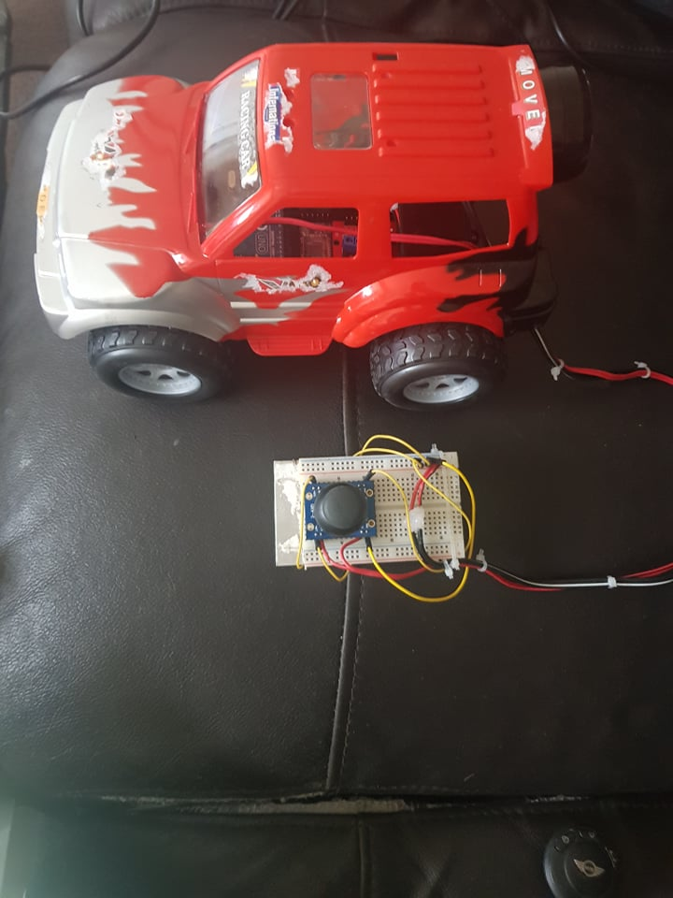
Arduino Development
We purchased a remote control car. We took apart the car and cut the
factory controls out. We looked at the motor to see if we were able to use it. We
inserted a servo to control the movement of the front wheels. This has a limited
turn scope.
The joystick sits on a breadboard which is connected directly to the
Arduino and controls the movement of the
Car.
The joystick is a Potentiometer(variable resister) for the x and y axis.

Slide 10
Difficulties faced
We were unable to get the car to reverse as we did not have the hardware to do this. We would need a H bridge to allow the motor to spin in opposite directions.
The Arduino only allows two LED lights per pin. We did not have enough wires to connect all the lights.

Slide 11
Future Development
We will connect the code to the Arduino board via Bluetooth. This will eliminate wires and allow the car to be more mobile.

